Slide 1

Airbnb price optimization prediction
botond biró, Saahas bondalapati, zsombor tóth 21.04.2026.

Slide 2
The problem with the current system
AirBnB pricing is very inconsistent across listings
Hosts often underprice or overprice
Our goal is:
to predict optimal listing prices based on apartment features
to identify pricing inefficiencies
to estimate revenue impact

Slide 3
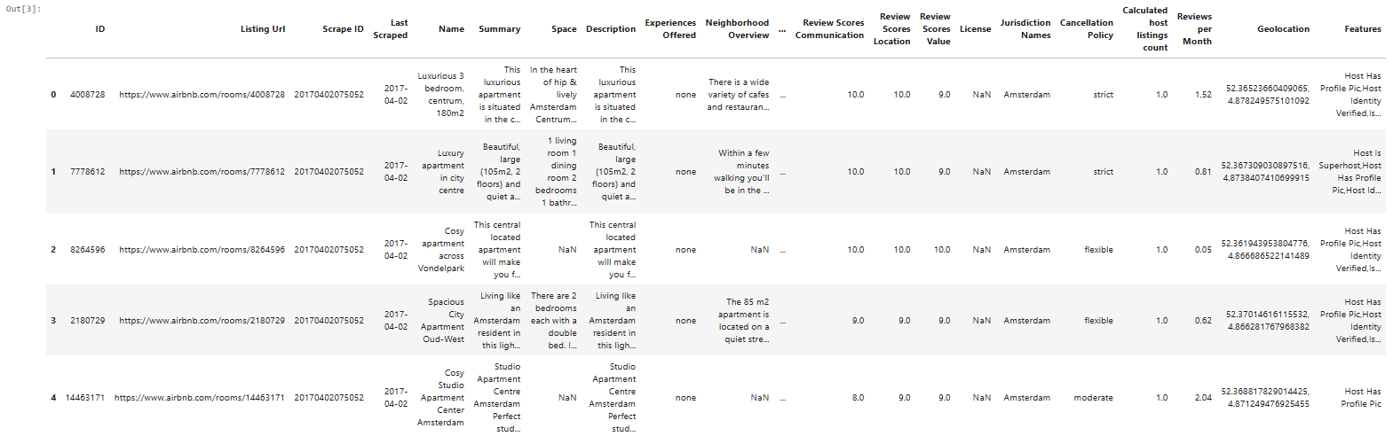
Dataset overview
Source: https://www.kaggle.com/datasets/joebeachcapital/airbnb/data
Key variables: price, location, property details such as no. of beds, bathrooms, etc., reviews and amenities

Slide 4
Data cleaning and pre-processing
Removed invalid and missing data values
Encoded categorical variables such as room type, city
Created binary amenity features (wifi, kitchen, TV, pool)

Slide 5
Feature engineering – why our model is strong
Property features (beds, bathrooms etc.)
Review metrics
Amenity indicators
Spacial feature (H3 hexagons)

Slide 6
H3 spatial logic
Latitude/longitude is converted into a hexagonal grid
Computed median price per hex cell
Leading to a created feature of h3_price_median
Neighbourhood-level pricing strategies available

Slide 7
Model development
Baseline was Random Forest
Final: GPU-accelerated XGBoost
performed a lot better than Random Forest

Slide 8
Model performance
MAE: ~0.239
RMSE: ~0.317
R²: ~0.82
The model explains appr. 82% of price variation

Slide 9
Key features driving price
Accomodates, bedrooms, bathrooms
Reviews and ratings
Important amenities
h3_price_median

Slide 10
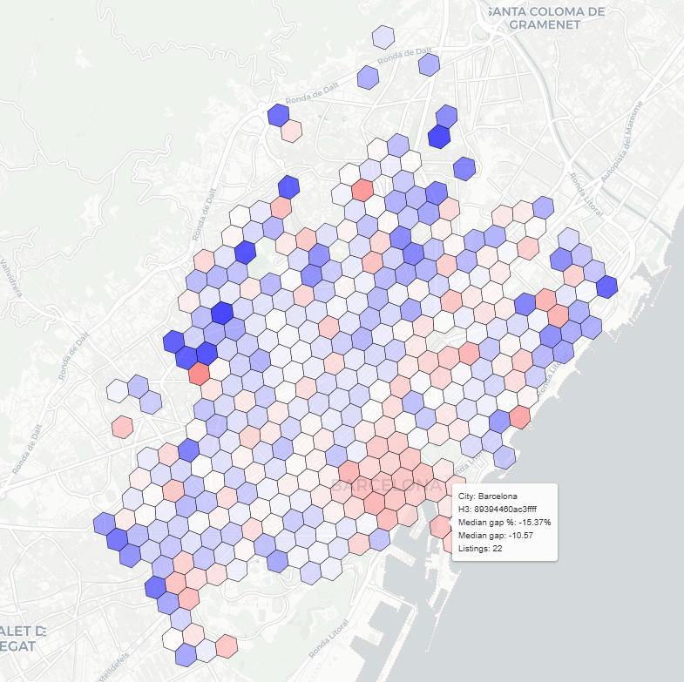
H3 pricing maps - barcelona
Lists:
H3 ID
Gap to median in both directions in both percentage and price
No. of listings in the given hexagon
Blue: underpriced, opportunity
Red: overpriced, increased risk

Slide 11
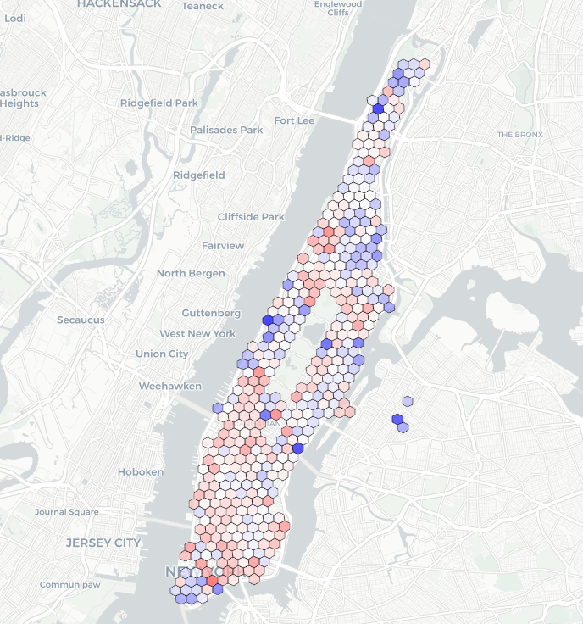
H3 pricing maps – new york
Lists:
H3 ID
Gap to median in both directions in both percentage and price
No. of listings in the given hexagon
Blue: underpriced, opportunity
Red: overpriced, increased risk

Slide 12
Revenue simulation
Steps applied before:
Adjusted prices based on the model
Used availability as occupancy proxy
Tested price elasticity scenarios
Ran multiple simulations with
Different price changes
Different demand assumptions
Outcome depends on the strategy too, not just the model

Slide 13
Business insights
Full price alignment IS NOT the best possible outcome
Conservative price increase works the best
Estimated impacts:
Realistically 2-3%
Optimistically up to 5%

Slide 14
limitations
Revenue is simulated, is not real data
Uses proxies such as elasticity, availability
No causal proof

Slide 15
COnclusion
Accurate price prediction achieved
Spatial modeling significantly improved results
Practical for identifying pricing inefficiencies and supports dynamic decisions

